Slide 1
Containers at Scale with Kubernetes, Docker and Azure
Jennelle Crothers Sr. Technical Evangelist - Microsoft www.techbunny.com| @jkc137 Jennelle.Crothers@Microsoft.com

Slide 2
Tutorial Information
For current tutorial steps, slides and other references:
https://github.com/techbunny/LISA17

Slide 3
Agenda
Containers and Common Cloud Computing Models
Getting Started (with Docker)
Using Azure Registry
To the Cloud with Azure Container Instances
What does a Container Service do for me?

Slide 4
But first…

Slide 5
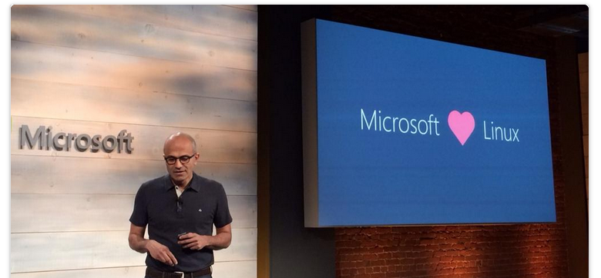

Slide 6



We also really like Docker. Docker integration - joint strategic investments to drive containers forward
Docker Hub in Azure: Huge collection of open and curated applications available for download
Collaboration: Bring Windows Server containers to the Docker ecosystem to expand the reach of both developer communities
Docker Engine: Docker Engine for Windows Server containers will be developed under the aegis of the Docker open source project
Docker client: Windows customers will be able to use the same standard Docker client and interface on multiple development environments
Docker Client
Docker.exe
Examples:
docker run
docker images
Windows Server
Linux
Docker Remote API
Examples:
GET images/json
POST containers/create
Docker Engine
(Daemon)
Docker Engine
(Daemon)
Windows Server
Container Support
Linux Container
Support (LXC)

Slide 7
Agenda
Containers and Common Cloud Computing Models
Getting Started with Docker
Using Azure Registry
To the Cloud with Azure Container Instances
What does a Container Service do for me?

Slide 8
Cloud Computing Models
On-Premises
( Private Cloud )
Infrastructure
( as a Service )
Platform
( as a Service )
Software
( as a Service )
You Manage
Data & Access
Data & Access
You Manage
Data & Access
Data & Access
You Provision & Manage
You Provision & Manage
Applications
Applications
Applications
Applications
Provisioned & Managed by Vendor
Runtime
Runtime
Runtime
Provisioned & Managed by Vendor
Runtime
Operating System
Operating System
Operating System
Operating System
Virtual Machine
Virtual Machine
Virtual Machine
Virtual Machine
Physical Fabric Managed by Vendor
Compute
You Provision Cloud Services
Compute
Compute
Compute
Networking
Networking
Networking
Networking
Storage
Storage
Storage
Storage
Host
Develop
Consume

Slide 9
Cloud Computing Models
On-Premises
( Private Cloud )
Infrastructure
( as a Service )
Platform
( as a Service )
Software
( as a Service )
You Manage
Data & Access
Data & Access
You Manage
Data & Access
Data & Access
You Provision & Manage
Applications
Applications
Applications
Applications
You Provision & Manage
Containers Live Here
Provisioned & Managed by Vendor
Runtime
Runtime
Runtime
Provisioned & Managed by Vendor
Runtime
Operating System
Operating System
Operating System
Operating System
Virtual Machine
Virtual Machine
Virtual Machine
Virtual Machine
Physical Fabric Managed by Vendor
Compute
You Provision Cloud Services
Compute
Compute
Compute
Networking
Networking
Networking
Networking
Storage
Storage
Storage
Storage
Host
Develop
Consume

Slide 10
Use containers a few different ways…
Build Your Own Infrastructure (BYOI)
On Bare Metal
On IaaS (Azure, AWS, etc)
On a “Container Service”
You pick the Orchestrator
The servers are “hosted” by your cloud provider (Their IaaS is your SaaS)
BYO on Azure with Azure Container Engine
As part of a Microservices “fabric” deployment

Slide 11
Agenda
Containers and Common Cloud Computing Models
Getting Started (with Docker)
Using Azure Registry
To the Cloud with Azure Container Instances
What does a Container Service do for me?

Slide 12
Containers at the smallest scale…
Docker for Windows (or Mac)
Images: Local Machine, Public or Private Registry
Deployment: Local Machine
Everything Local

Slide 13
Containers at the smallest scale…
Docker for Windows (or Mac)
Images: Local Machine, Public or Private Registry
Deployment: Local Machine
Everything Local
Consistent development environment; reduces the “works on my machine” problem.
Allows for containers to be source controlled as programming artifacts.

Slide 14
Containers beyond development
Deploy to Server
Container Host (docker-engine)
Deployment: Local Server or IaaS
Docker for Windows (or Mac)
Images: Local Machine

Slide 15
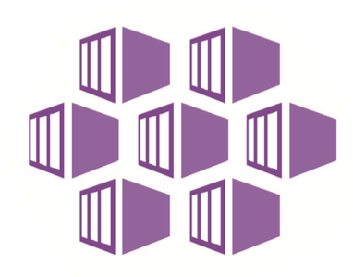
Containers scale up for production
Scale Your Own Infrastructure
Clustered Container Host
Deployment: Local Servers or IaaS
Add an Orchestrator
(Optional) Use Scale-Sets
Container Services
Clustered Container Hosts “as a Service”
Deployment: Cloud CaaS
Orchestrator pre-installed (Docker Swarm, DC/OS, Kubernetes) Scale-set configuration is managed by service, based on deployment choices.

Slide 16
Some examples…
Linux Containers on Linux VMs
Clustered (or not) using IaaS with docker-machine
Windows Containers on Windows Server 2016
Containers on Windows 10 with Docker for Windows
Docker Datacenter in Azure Marketplace
30-Day Evaluation License Available via Docker
Linux Containers using Azure Container Services
With Docker, DC/OS or Kubernetes
Windows Containers supported with Kubernetes
Linux Containers using Azure Container Instances
Currently in Preview

Slide 17
Windows Server + Linux Containers
Host User Mode
Virtual Machine Specifically Optimized To Run a Container
Virtual Machine Specifically Optimized To Run a Container
System Processes
Container Management
Session Manager
Hyper-V Container
Hyper-V Container
Docker Engine
Local Security Authority
Linux Container
Windows Server Container
Compute Services
Etc…
System Processes
Application Process(es)
System Processes
Application Process(es)
Windows Kernel
Linux Kernel
Windows Kernel
Hyper-V Hypervisor
** Disclaimer: This is my personal visualization/explanation of this Windows Server 1709 feature.**

Slide 18
CI/CD is super helpful.
Commit code to Repo
Build Container
Push to Registry
Deploy to Cloud
CI/CD
CI/CD
CI/CD

Slide 19
CI/CD is super helpful. Just not today.
Commit code to Repo
Build Container
Push to Registry
Deploy to Cloud
CI/CD
CI/CD
CI/CD
Build Container Manually
Push to Registry Manually
Deploy to Cloud Manually

Slide 20
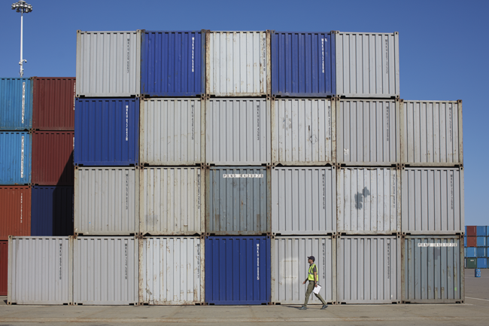
DEMO: Containerizing an Application

Slide 21
Agenda
Containers and Common Cloud Computing Models
Getting Started (with Docker)
Using Azure Registry
To the Cloud with Azure Container Instances
What does a Container Service do for me?

Slide 22
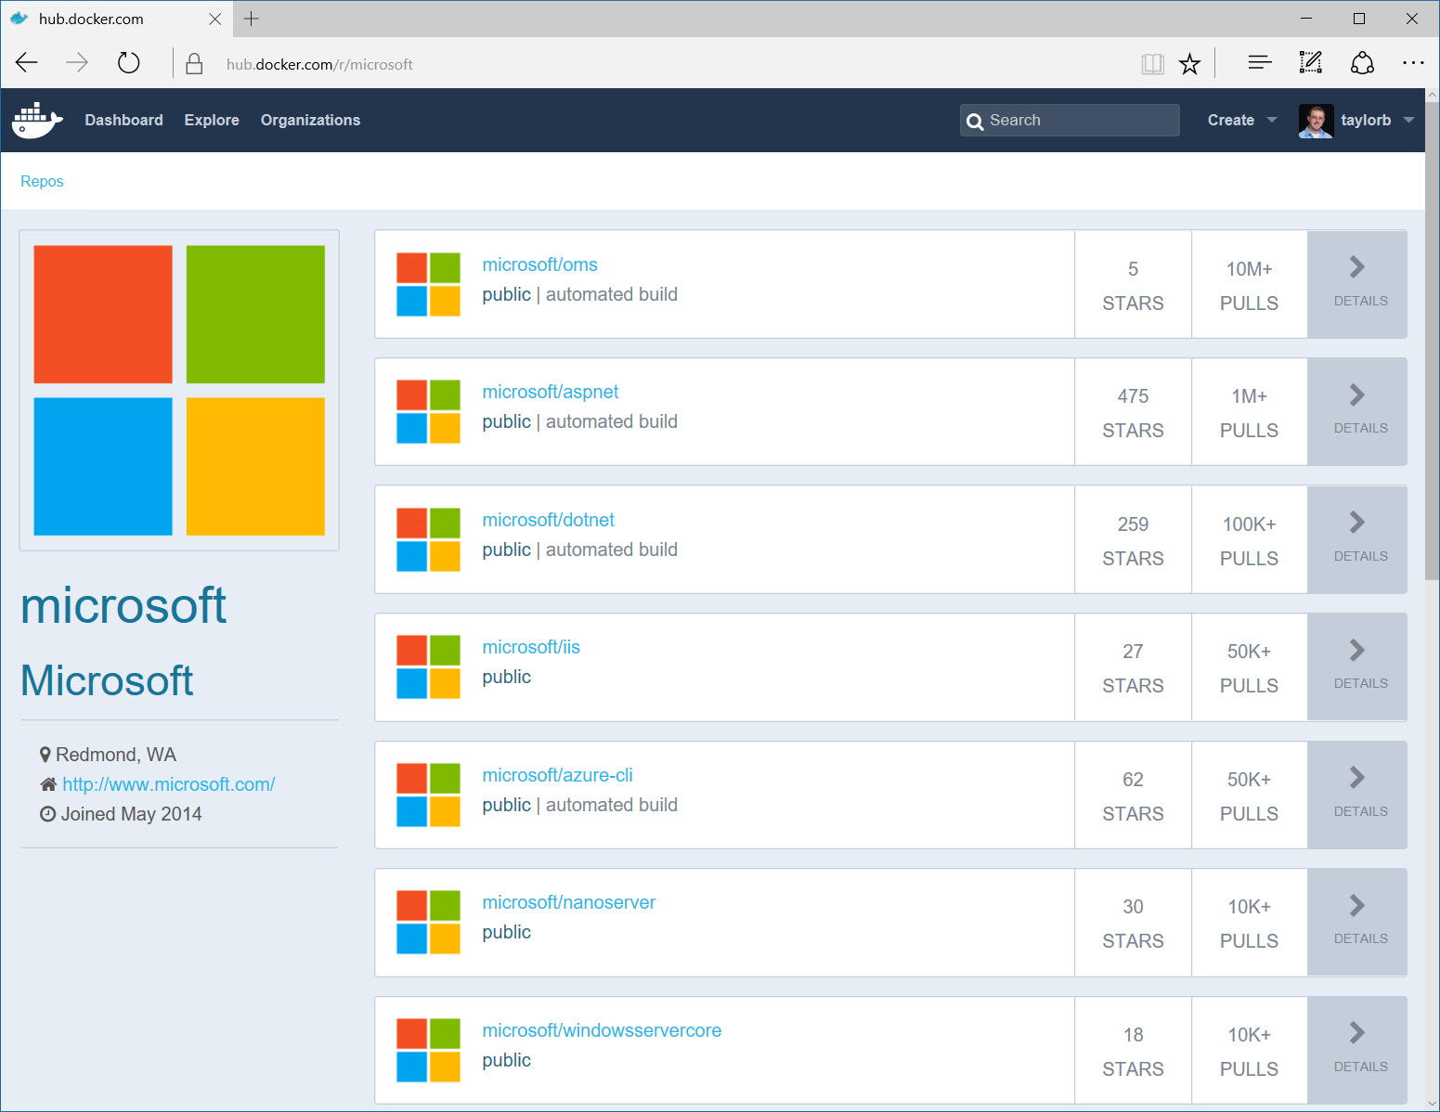
Image Registries
Docker Hub and Docker Store
Public, Official and Private image repositories
Granular access controls with organization support
Automated image build support
Docker Trusted Registry
Enterprise Grade Private Registries
Runs on your infrastructure (on-prem or cloud)
Active Directory and Role Based Access Controls
Docker Registry
Open source foundation of Hub and DTR
Runs on your infrastructure (on-prem or cloud) as a container
https://docs.docker.com/registry and or https://github.com/docker/distribution
Azure Container Registry
Generally Available in 23 Regions
Store your container image in local, network-close storage on Azure
Use Azure Active Directory to manage access
Manage Windows and Linux container images in a single registry

Slide 23
Container Management with Registries
Clustered Container Host
Deployment: Local Servers or IaaS
Add an Orchestrator
(Optional) Use Scale-Sets
Docker for Windows (or Mac)
Images: Local Machine

Slide 24

Container Management with Registries
Image Registry
Clustered Container Host
Deployment: Local Servers or IaaS
Add an Orchestrator
(Optional) Use Scale-Sets
Code Repo
Docker for Windows (or Mac)
Images: Local Machine

Slide 25
Container Management with Registries
Image Registry
Clustered Container Host
Deployment: Local Servers or IaaS
Add an Orchestrator
(Optional) Use Scale-Sets
Code Repo
Docker for Windows (or Mac)
Images: Local Machine

Slide 26
Notes for Azure Container Registry
Several Different SKUs
Classic
Basic
Standard
Premium
Classic is billed at the standard rates based on consumption of Blob Storage and Networking. No incremental charges for the registry it self.
Basic, Standard and Premium provides additional capabilities, such as Azure AD authentication, webhook support and delete operations.

Slide 27
Geo Replication for ACR (Preview)
Single registry/image/tag names can be used across multiple regions
Network-close registry access from regional deployments
No additional egress fees. Images are pulled from a local, replicated registry in the same region as your container host
Single management of a registry across multiple regions
Supported in Premium registries only.

Slide 28

DEMO: Azure Container Registry

Slide 29
Agenda
Containers and Common Cloud Computing Models
Getting Started (with Docker)
Using Azure Registry
To the Cloud with Azure Container Instances
What does a Container Service do for me?

Slide 30
Azure Container Instances
A solution for any scenario that can operate in isolated containers, including simple applications, task automation, and build jobs.
For scenarios where you need full container orchestration, including service discovery across multiple containers, automatic scaling, and coordinated application upgrades consider Azure Container Service
Features include fast startup time, hypervisor-level security, custom sizes, public IP connectivity, persistent storage via Azure file shares.
Support for Linux and Windows containers
Co-scheduled groups that share a host machine, local network, storage and lifecycle.

Slide 31
Azure Container Instances
Preview is currently available in West Europe, West US and East US.
For long-running, stable workloads, orchestrating containers in a cluster of dedicated virtual machines will typically be cheaper than running the same containers with Container Instances.

Slide 32
Container Instances with Kubernetes
Underlying infrastructure for Container Instances is managed by Azure, an orchestrator platform does not need to concern itself with finding an appropriate host machine on which to run a single container.
Orchestrator platforms can be used to manage multi-container tasks on top of ACI.
ACI-Connector for Kubernetes is available in beta.

Slide 33
DEMO: Azure Container Instances

Slide 34
Agenda
Containers and Common Cloud Computing Models
Getting Started (with Docker)
Using Azure Registry
To the Cloud with Azure Container Instances
What does a Container Service do for me?

Slide 35

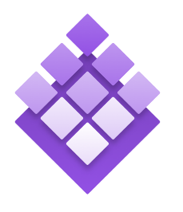
Azure Container Service
Azure
Standard Docker tooling and API support
Streamlined provisioning of Docker Swarm, DCOS and recently Kubernetes
Linux and Windows Server containers
Azure and Azure Stack
Swarm
DC/OS

Slide 36
Azure Container Services (ACS)
Microsoft isn’t the only one - EC2 Container Service, Google Container Engine….
Azure Container Service makes it simpler to create, configure, and manage a cluster of virtual machines that are preconfigured to run containerized applications.
Azure Container Service leverages the Docker container format to ensure that your application containers are fully portable.
It also supports your choice of Marathon and DC/OS, Docker Swarm, or Kubernetes so that you can scale these applications to thousands of containers, or even tens of thousands.

Slide 37
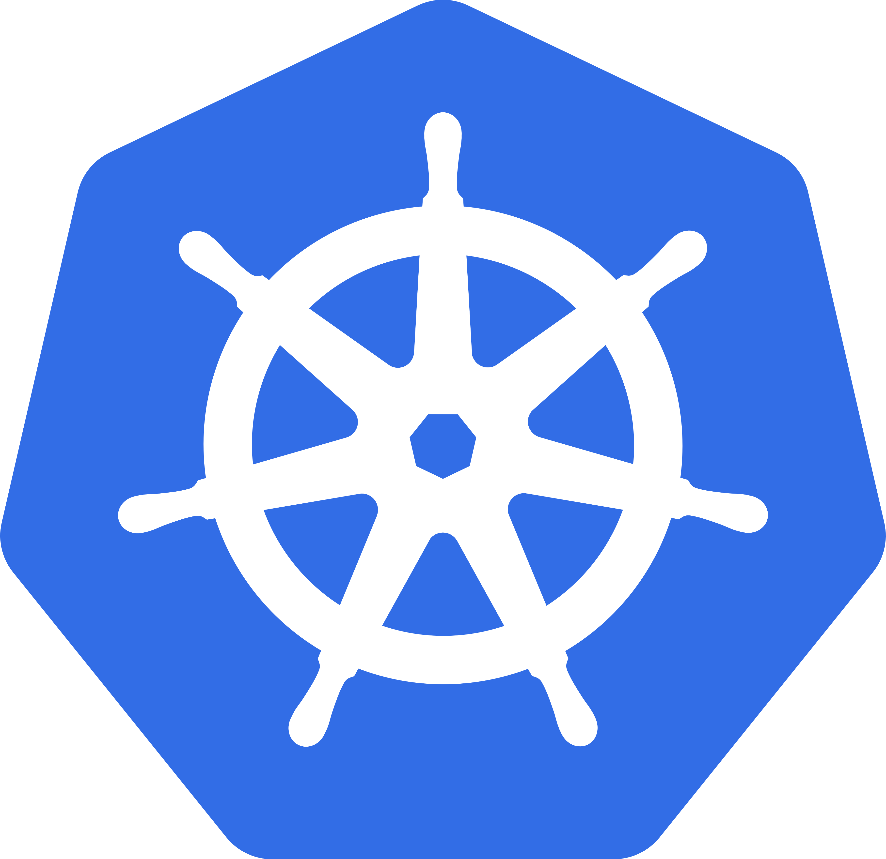
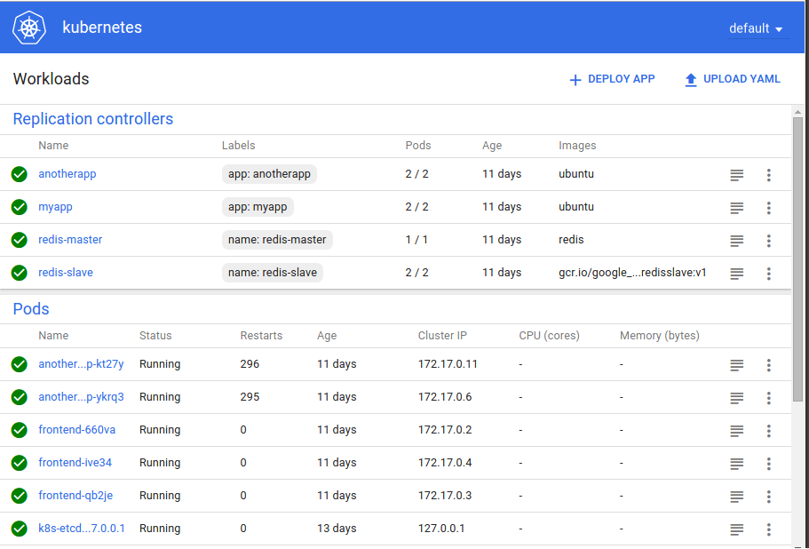
ACS with Kubernetes
Kubernetes
Kubernetes is a popular open-source production grade container orchestrator tool for automated container deployment, scaling and management of containerized applications.
Open source project started by Google

Slide 38
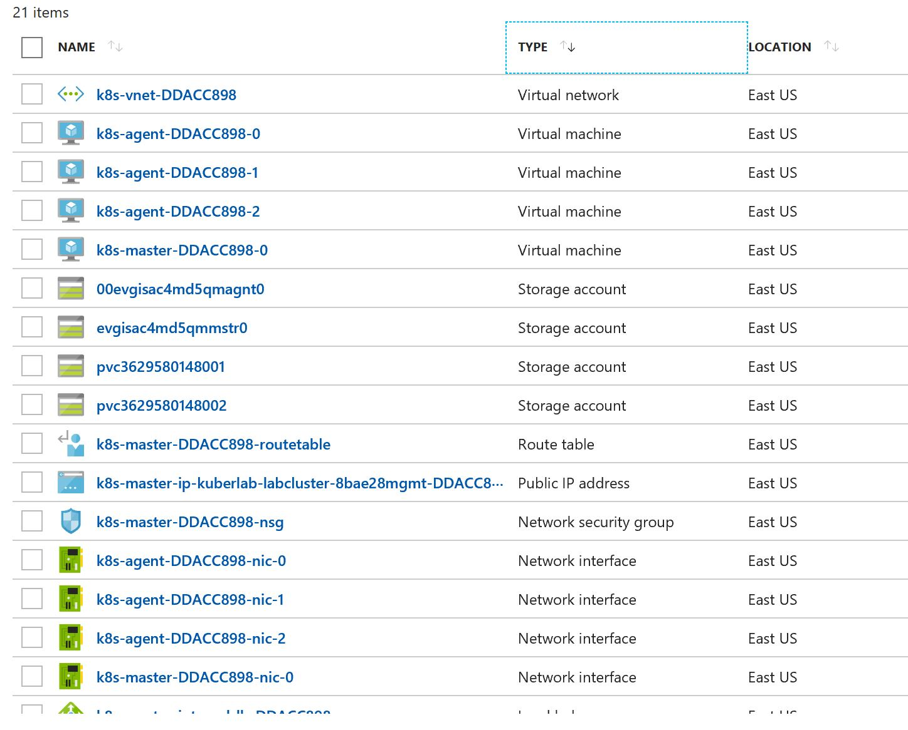
ACS What do you get?
Virtual Network
VMs for agents AND master
Storage accounts for disks
Public IP, Route Table, NSG, NICs….
Load balancer and availability sets for both agents and master
Container Service object

Slide 39
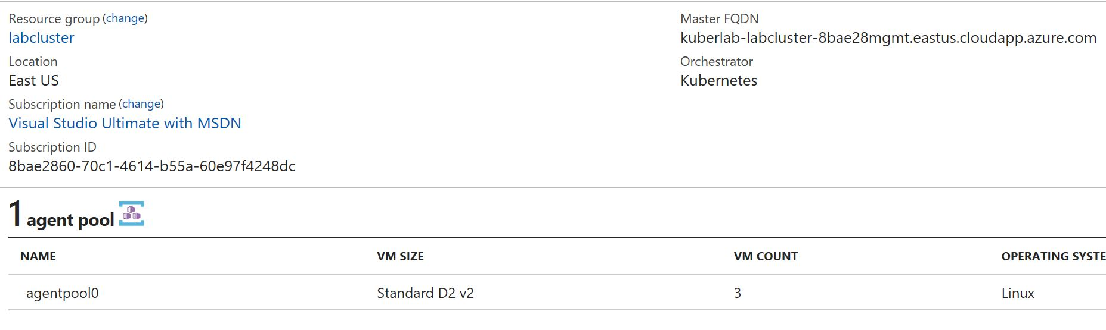
ACS What do you get?
Virtual Network
VMs for agents AND master
Storage accounts for disks
Public IP, Route Table, NSG, NICs….
Load balancer and availability sets for both agents and master
Container Service object

Slide 40
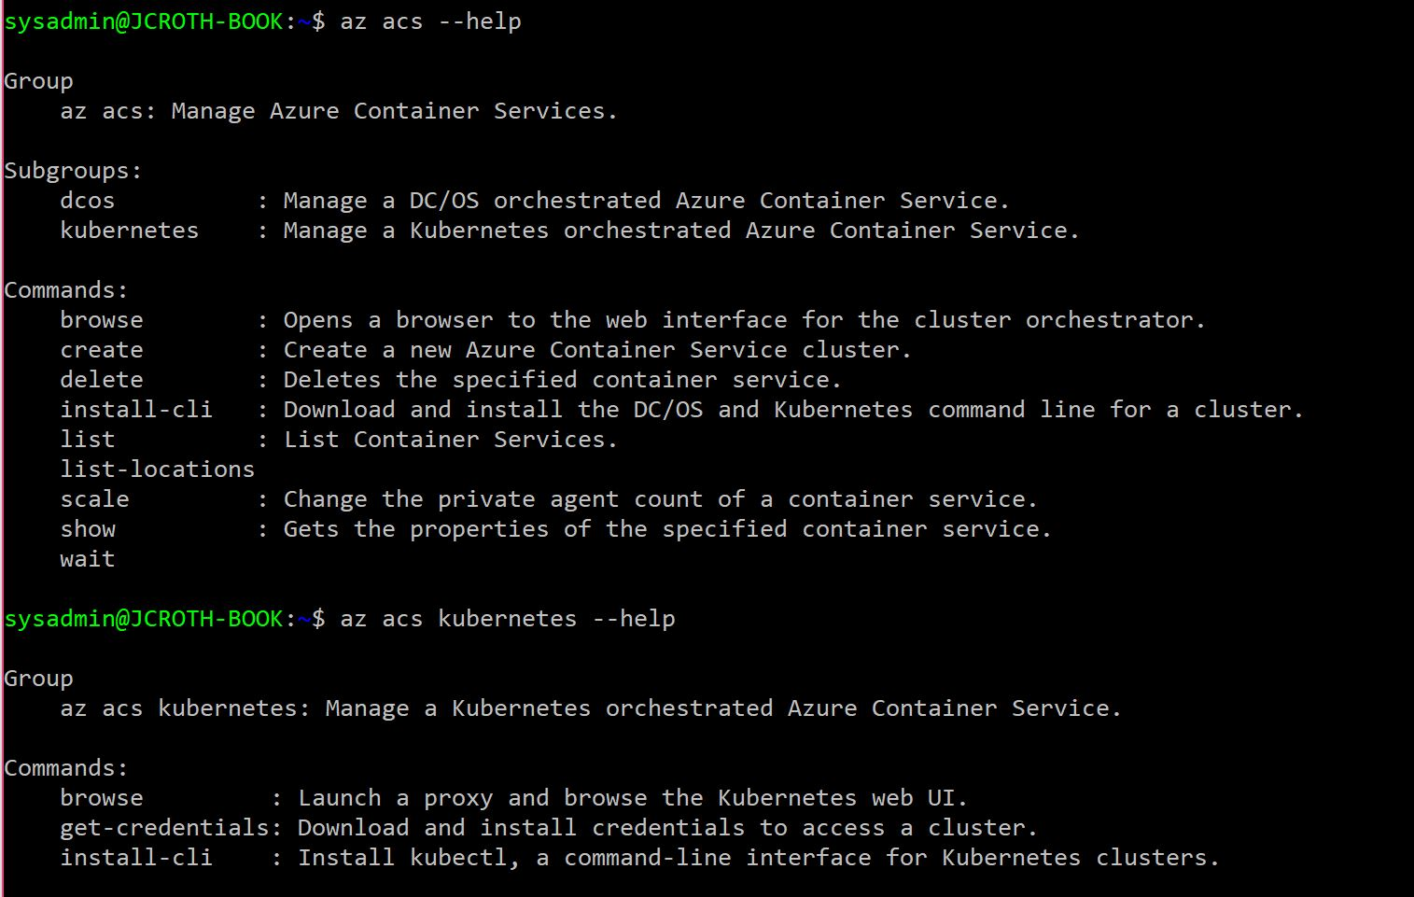
ACS via Azure CLI 2.0

Slide 41
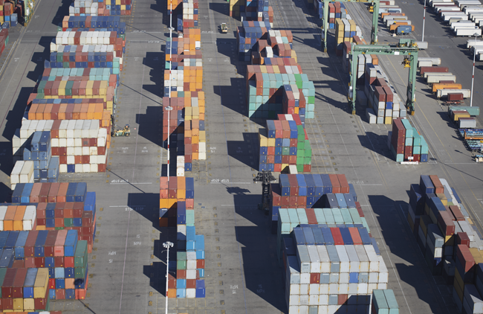
DEMO: Azure Containers Services

Slide 42
Azure Container Services (AKS)
IN PREVIEW
Free* container service that simplifies the deployment, management, and operations of Kubernetes by providing a fully managed Kubernetes container orchestrator service.
Azure-hosted control plane, automated upgrades, self-healing, easy scaling, and a simple user experience.
Monitoring available via the OMS portal.

Slide 43
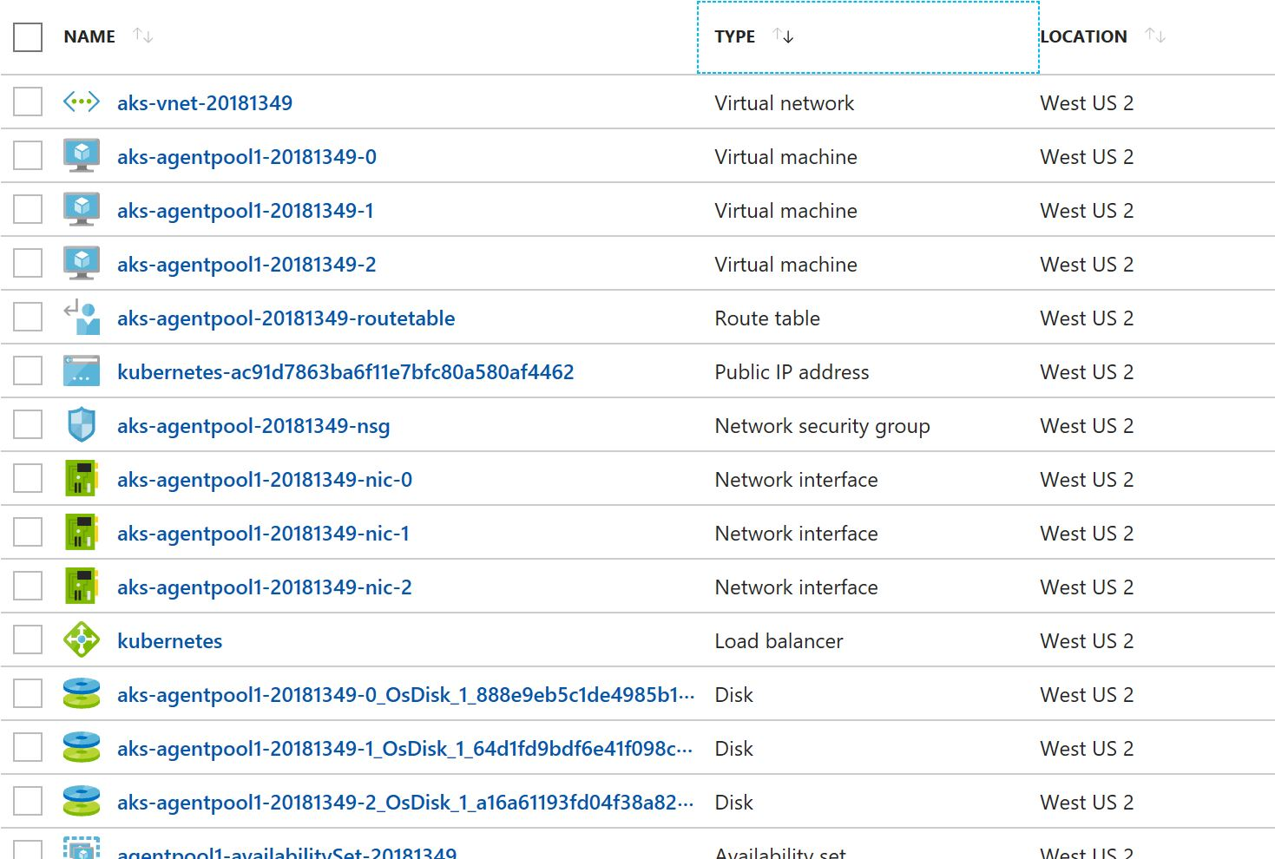
AKS What do you get?
Virtual Network
VMs for agents ONLY
Managed Disks
Public IP, Route Table, NSG, NICs….
Load balancer and availability set for agents ONLY
Managed container service object in separate Resource Group

Slide 44
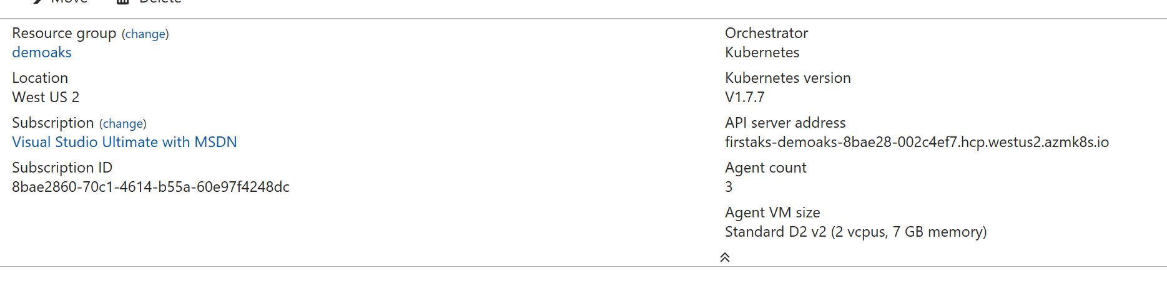
AKS What do you get?
Virtual Network
VMs for agents ONLY
Managed Disks
Public IP, Route Table, NSG, NICs….
Load balancer and availability set for agents ONLY
Managed container service object in separate Resource Group

Slide 45
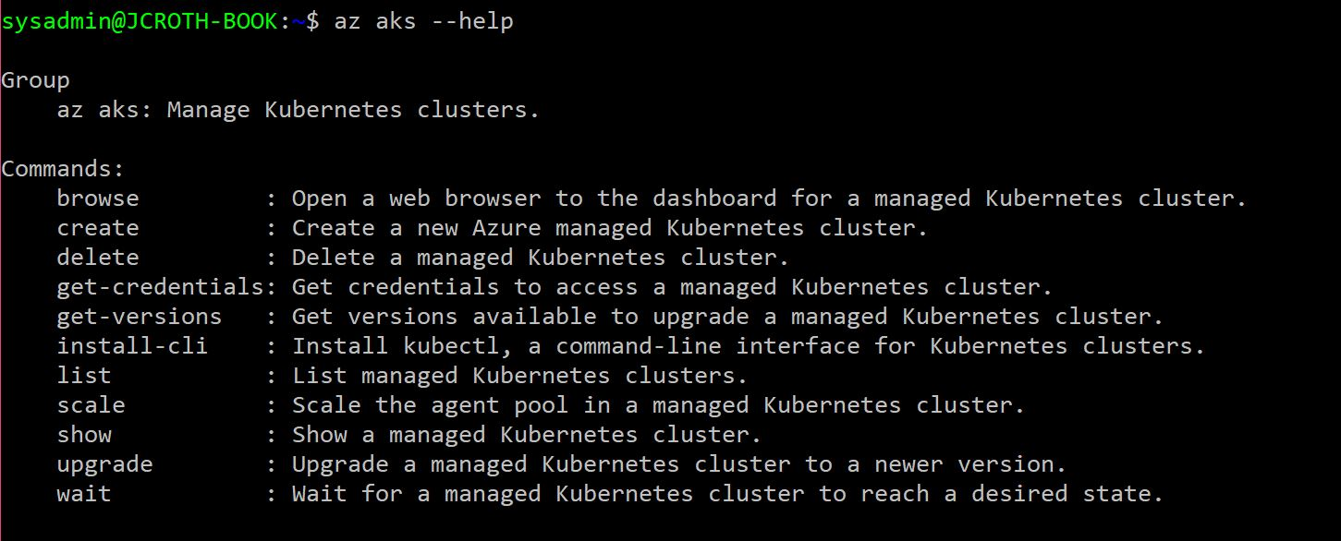
AKS via Azure CLI 2.0

Slide 46
Azure Container Service - ACS vs AKS
ACS (generally available)
AKS (in preview)
Support for DC/OS, Kubernetes and Docker Swarm, with swarm-mode in preview.
Windows Containers supported on Kubernetes deployment.
Manual node upgrades required
Pay for compute/VM costs for agents and master
Support for Kubernetes only
Linux containers only
Node upgrades supported
Pay for compute/VM costs for agents only. Management node is free.

Slide 47
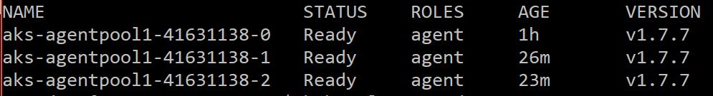
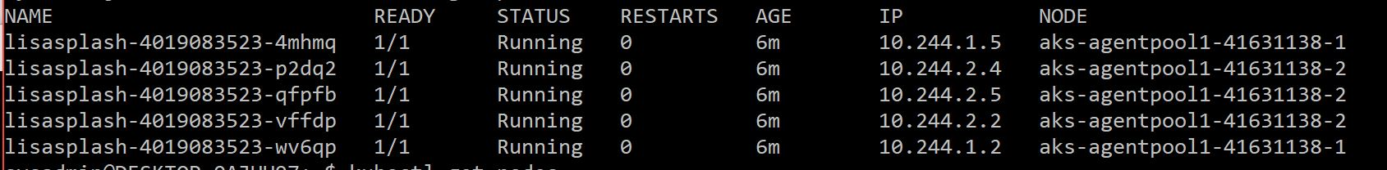
AKS Upgrade Process

Slide 48
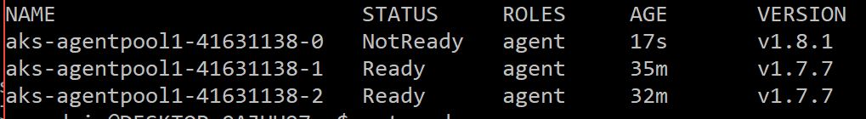
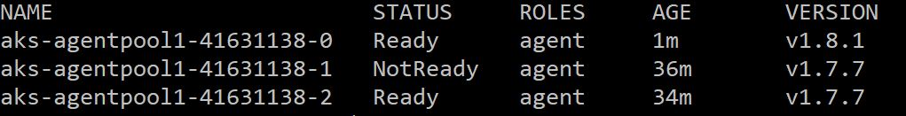
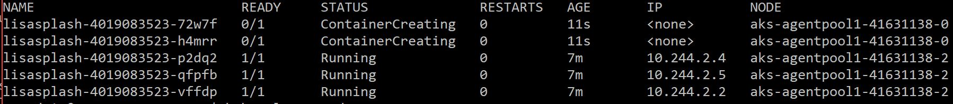
AKS Upgrade Process

Slide 49
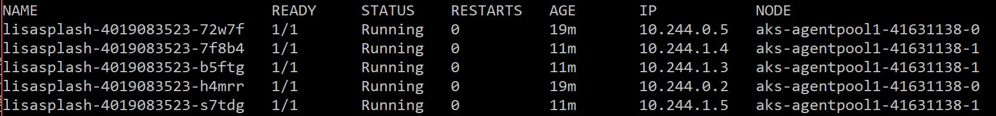
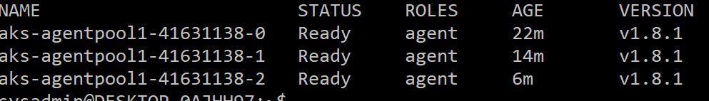
AKS Upgrade Process

Slide 50
What now?
Containers are the future.
Containers straddle a gap between developers of applications and those deploying infrastructure.
Your containers are the infrastructure you use to provide a service to someone else or the basis of someone else’s product, or both.
When you are choosing tools, think about:
Who is the consumer of the container?
How will containers connect with other parts of your application and existing infrastructure?
How much infrastructure do you want to manage to support your containers?
While many things can be containerized, don’t feel you have to put everything in a container. Start with things that will benefit from being able to scale quickly, deploy rapidly and need to be reproduced easily.

Slide 51
Thank You!
Jennelle Crothers Sr. Technical Evangelist - Microsoft www.techbunny.com| @jkc137 Jennelle.Crothers@Microsoft.com

